Slide 1

311 Call Center Tracking Data for City of LA
DSO 545: Statistical Computing and Data Visualization
Chris
Anderson
Snigdha
Goel
Deepa Rama
Hegde
H. Leo
Kim
Dzuy
Nguyen

Slide 2

Agenda
EXECUTIVE SUMMARY
BACKGROUND
DATA ANALYSIS
DATA VISUALIZATION
CONCLUSIONS
RECOMMENDATIONS

Slide 3
Executive Summary
SITUATION
Investigate Los Angeles 311 call center data to draw insights to enable more effective use of services and resources
KEY QUESTIONS
What do service requests tell us about the different neighborhoods in Los Angeles?
Increase robustness of analytics on existing data
CONCLUSIONS
CONSIDERATIONS
Geographic: concentration of calls in several locations such as DTLA
How can we use these characteristics to better serve the city’s inhabitants?
How can we use the analysis of this data to make public services more proactive and responsive?
Time: High concentration on Monday morning
Demographics: Pattern of largest band of callers
Increase Efficacy and efficiency of city services
Streamline 311 requests and responses
EXECUTIVE SUMMARY
BACKGROUND
DATA ANALYSIS
DATA VISUALIZATION
CONCLUSIONS
APPENDIX

Slide 4
Background
The City of Los Angeles’ 311 system acts as a central point for requests for non-emergency city service through a city-wide phone number
Requests to the 311 system can also be made through:
E-mail Self-service Webpage
Voicemail Smartphone apps Others
Wide range of services to include
Graffiti Removal Electronic Waste Removal
Illegal Dumping Pickup Homeless Encampment
Provided 2 datasets by the City of Los Angeles 311 department
Call Center Tracking Service Request
EXECUTIVE SUMMARY
BACKGROUND
DATA ANALYSIS
DATA VISUALIZATION
CONCLUSIONS
APPENDIX

Slide 5
Data Analysis
Data sources:
The caller center data consists of 311 call center data from years 2011 to 2015
The service request data consist of 311 service requests data originating from call center data from 2015 to 2016
U.S. Census data for social and economic data
Programs utilized:
R-Studio: statistical programming language
R-Studio packages:
stringr &lubridate: conversion of variables as required
dplyr: find calculated fields
ggplot2: data visualization
EXECUTIVE SUMMARY
BACKGROUND
DATA ANALYSIS
DATA VISUALIZATION
CONCLUSIONS
APPENDIX

Slide 6
Data Visualization
Who generally are the calls originating from?
What platform are the requests submitted on?
When are calls occurring?
Where are the calls coming from?
Why are the callers calling?
How are we doing with the requests?
EXECUTIVE SUMMARY
BACKGROUND
DATA ANALYSIS
DATA VISUALIZATION
CONCLUSIONS
APPENDIX

Slide 7
Who is calling?
Customer Segmentation and Trends
Data: Call Center (2011 – 2015)
EXECUTIVE SUMMARY
BACKGROUND
DATA ANALYSIS
DATA VISUALIZATION
CONCLUSIONS
APPENDIX

Slide 8
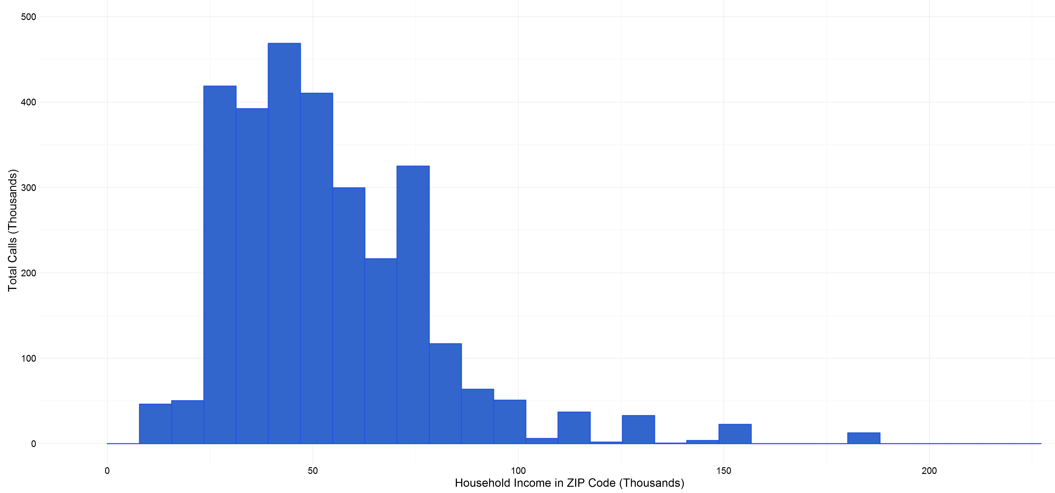
Who? Income vs Calls
High occurrence of calls originate from middle class areas
EXECUTIVE SUMMARY
BACKGROUND
DATA ANALYSIS
DATA VISUALIZATION
CONCLUSIONS
APPENDIX

Slide 9
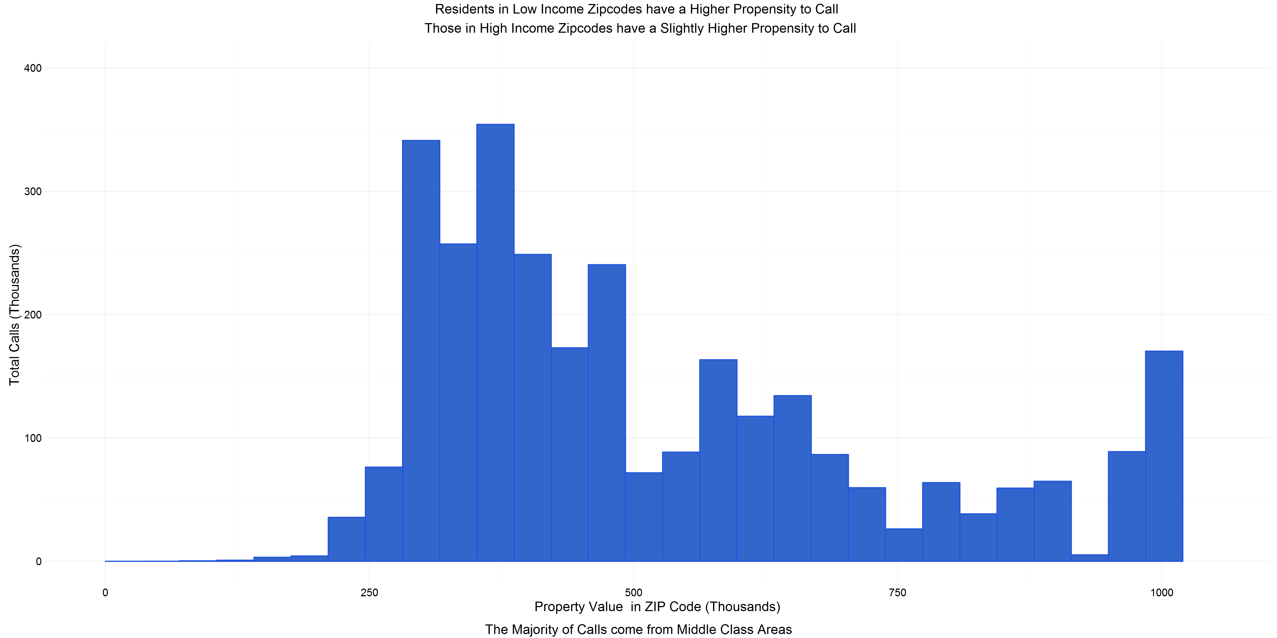
Who? Property Value vs Calls
High occurrence of calls originate from middle class areas
EXECUTIVE SUMMARY
BACKGROUND
DATA ANALYSIS
DATA VISUALIZATION
CONCLUSIONS
APPENDIX

Slide 10
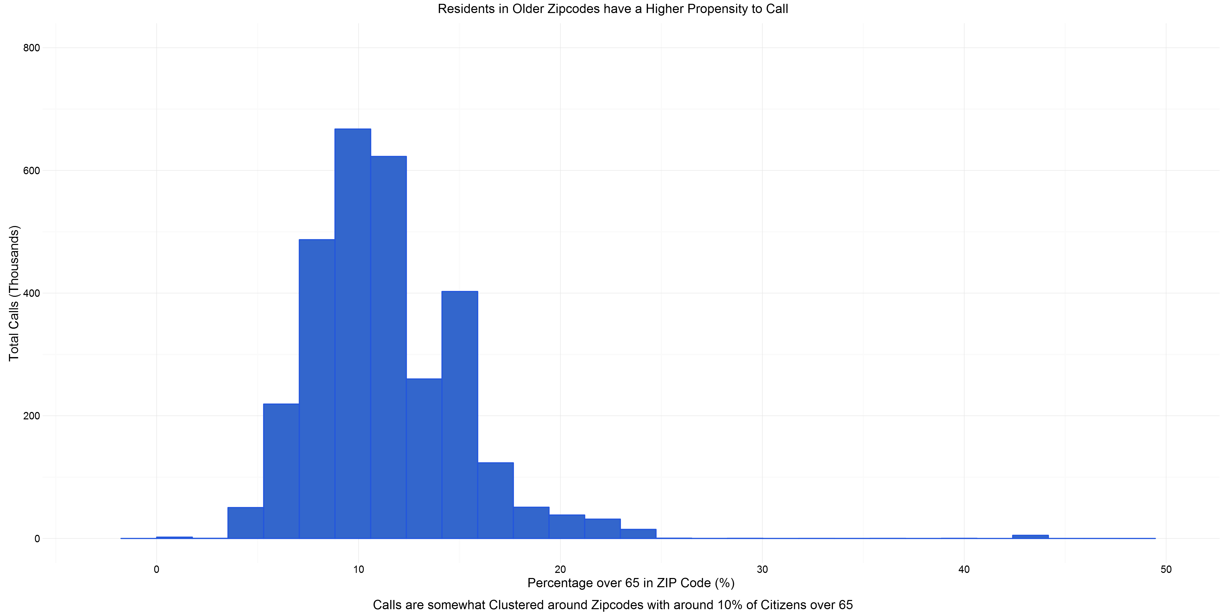
Who? Age vs Calls
Calls clustered around zip codes with approximately 10% of citizens over 65
EXECUTIVE SUMMARY
BACKGROUND
DATA ANALYSIS
DATA VISUALIZATION
CONCLUSIONS
APPENDIX

Slide 11
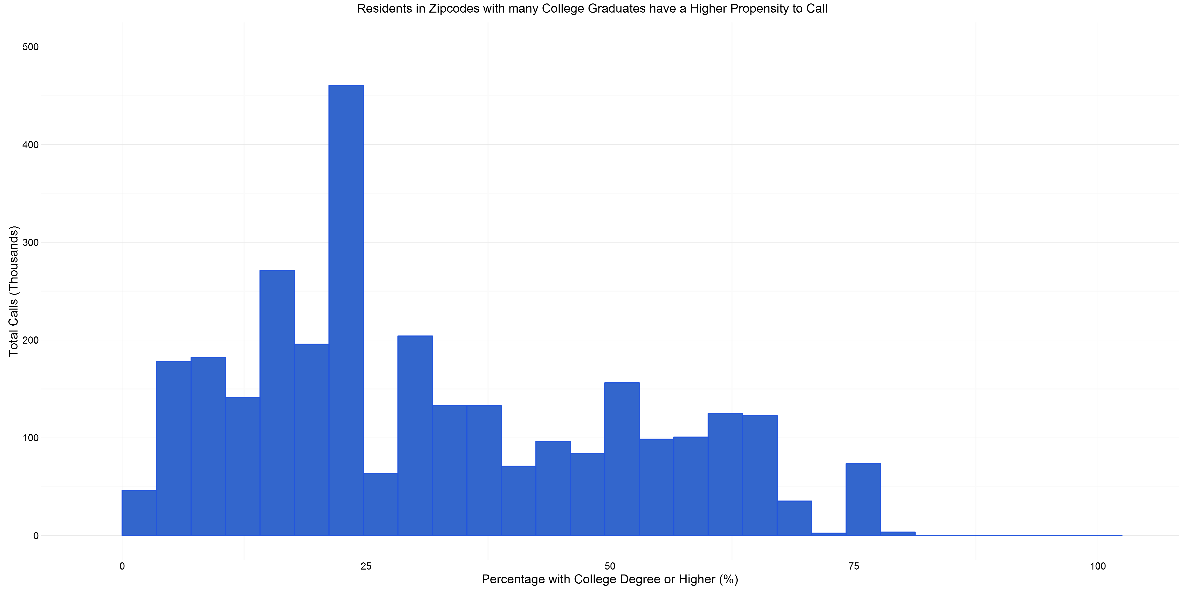
Who? Education vs Calls
Spike of calls from areas with low college graduates
EXECUTIVE SUMMARY
BACKGROUND
DATA ANALYSIS
DATA VISUALIZATION
CONCLUSIONS
APPENDIX

Slide 12
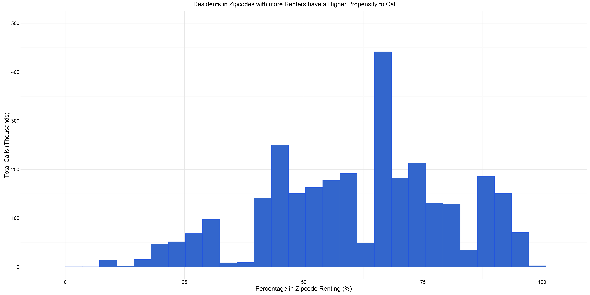
Who? Rent vs Calls
Majority of calls occur in zip codes where over half of residents are renters
EXECUTIVE SUMMARY
BACKGROUND
DATA ANALYSIS
DATA VISUALIZATION
CONCLUSIONS
APPENDIX

Slide 13
What platform are the customers using?
Platform Types and Usage
Data: Service Request (2015 – 2016)
EXECUTIVE SUMMARY
BACKGROUND
DATA ANALYSIS
DATA VISUALIZATION
CONCLUSIONS
APPENDIX

Slide 14
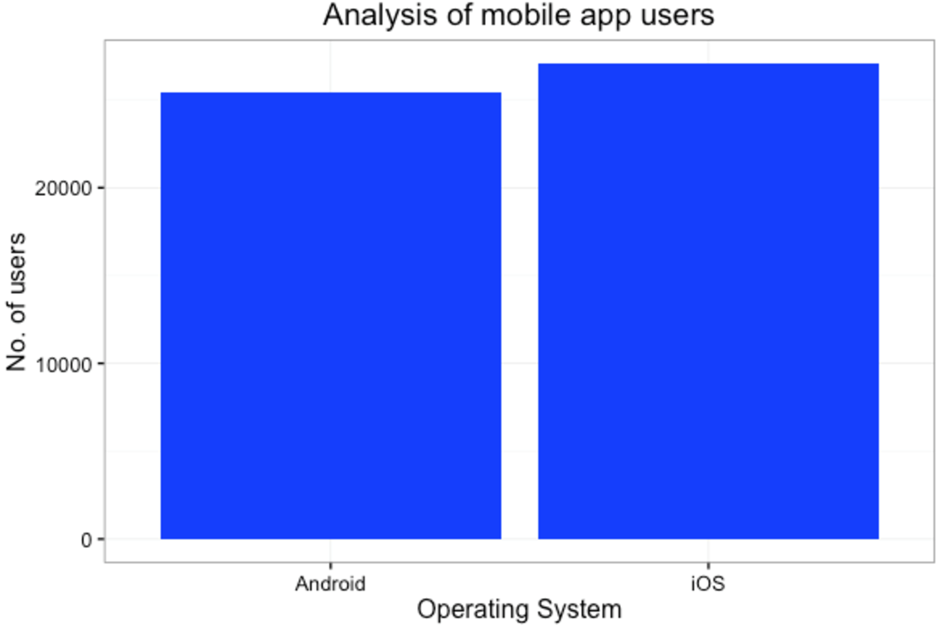
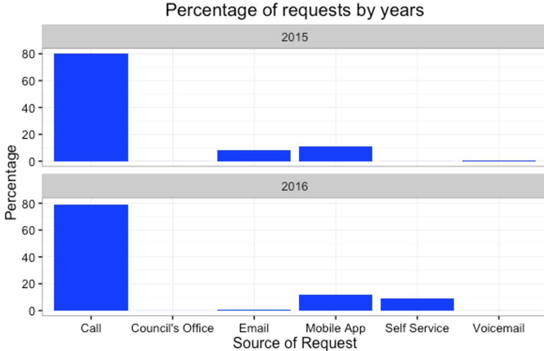
Platform Usage
Calling 311 is by far the largest platform for citizens to place a request
EXECUTIVE SUMMARY
BACKGROUND
DATA ANALYSIS
DATA VISUALIZATION
CONCLUSIONS
APPENDIX

Slide 15
When are calls occurring?
Daily and Hourly Analysis
Data: Service Request (2015 – 2016)
EXECUTIVE SUMMARY
BACKGROUND
DATA ANALYSIS
DATA VISUALIZATION
CONCLUSIONS
APPENDIX

Slide 16
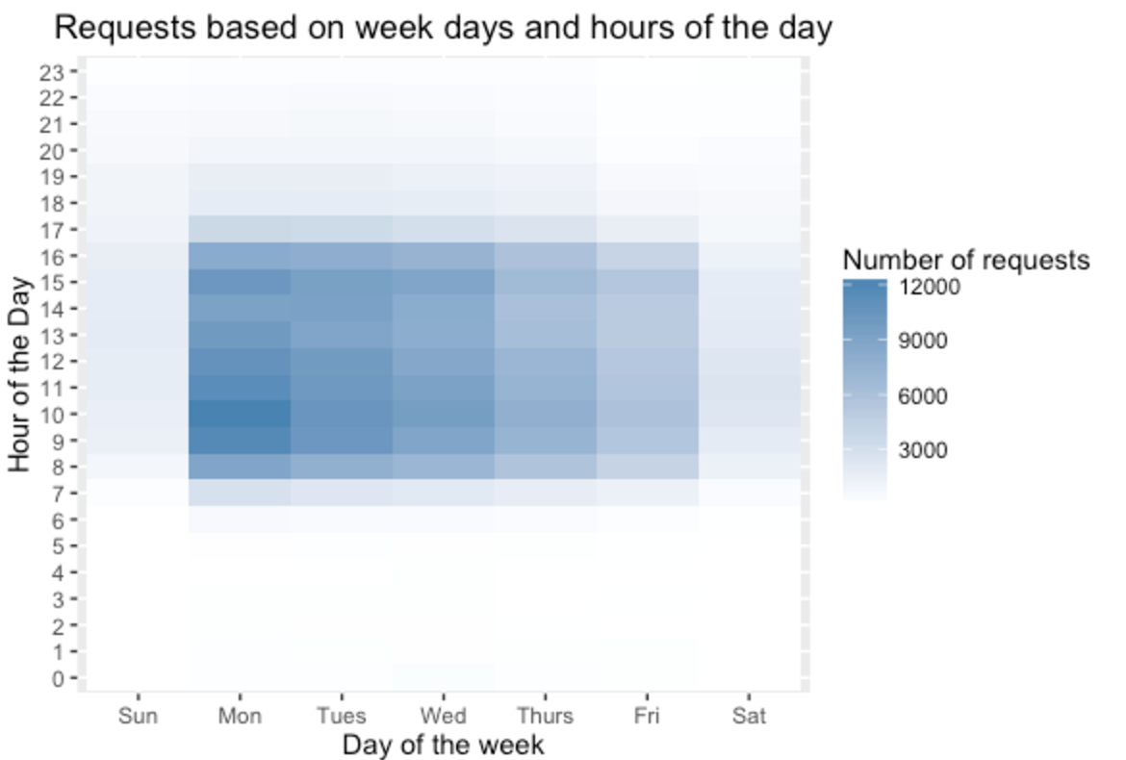
Request Timeframe
Concentration of calls on Monday concentrated around 10 am and 3 pm
EXECUTIVE SUMMARY
BACKGROUND
DATA ANALYSIS
DATA VISUALIZATION
CONCLUSIONS
APPENDIX

Slide 17
Where are the calls coming from?
Zip Code Segmentation, Geographic Overlay, and Visual Time Series
Data: Call Center (2011 – 2015)
EXECUTIVE SUMMARY
BACKGROUND
DATA ANALYSIS
DATA VISUALIZATION
CONCLUSIONS
APPENDIX

Slide 18
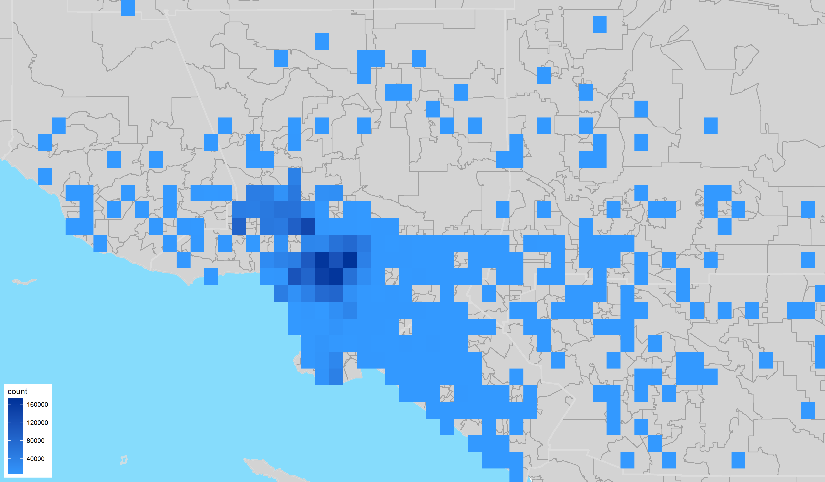
Call Concentration
EXECUTIVE SUMMARY
BACKGROUND
DATA ANALYSIS
DATA VISUALIZATION
CONCLUSIONS
APPENDIX

Slide 19
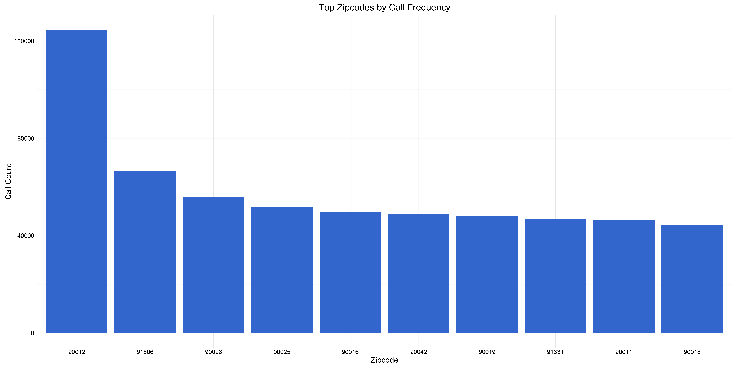
Top 10 Zip Codes with Calls
EXECUTIVE SUMMARY
BACKGROUND
DATA ANALYSIS
DATA VISUALIZATION
CONCLUSIONS
APPENDIX
Notes:
90012
91606
90026

Slide 20
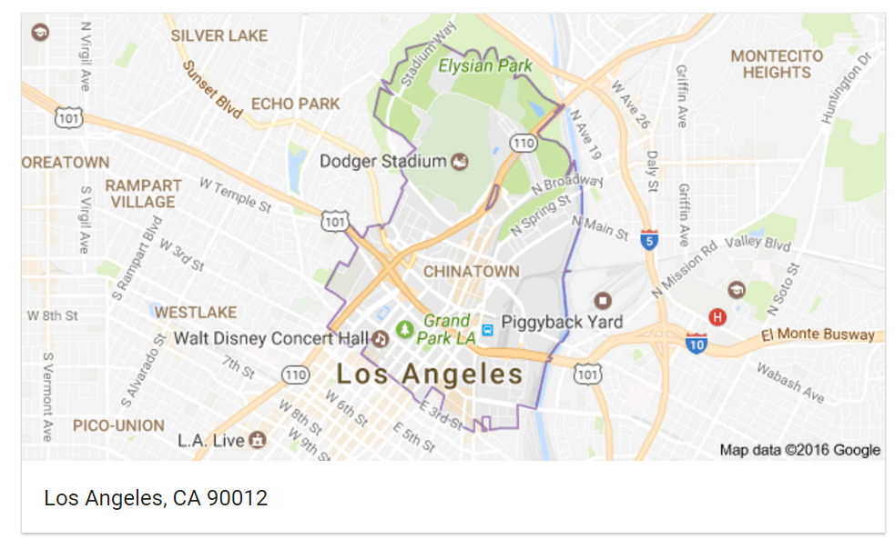
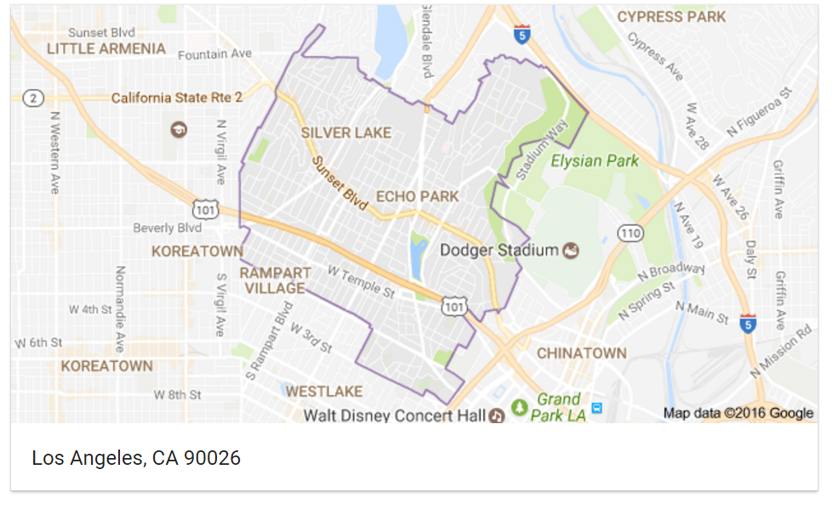
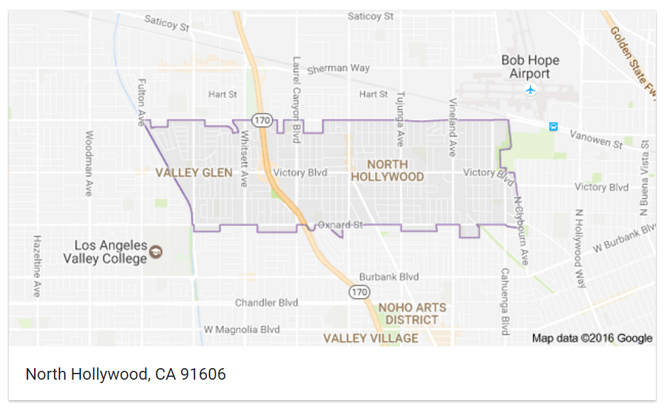
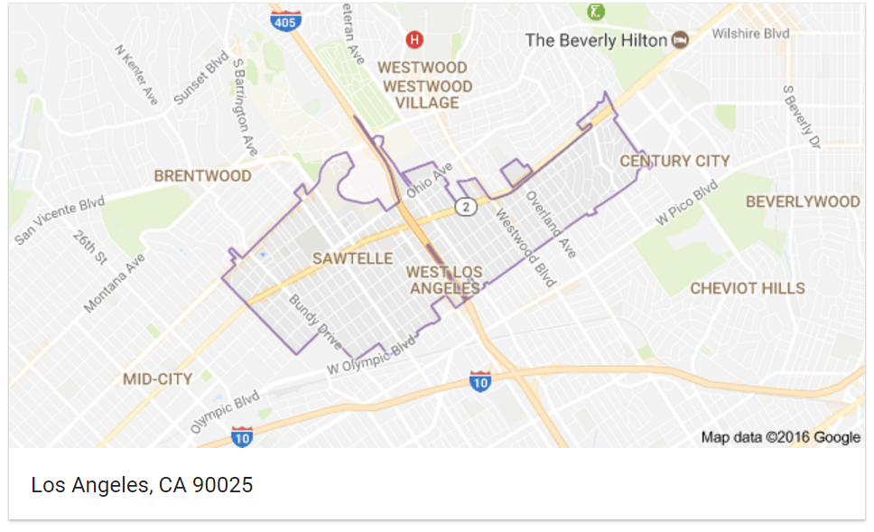
Top 4: Chinatown, N. Hollywood, Echo Park, & Sawtelle
EXECUTIVE SUMMARY
BACKGROUND
DATA ANALYSIS
DATA VISUALIZATION
CONCLUSIONS
APPENDIX
Notes:
90012
91606
90026

Slide 21
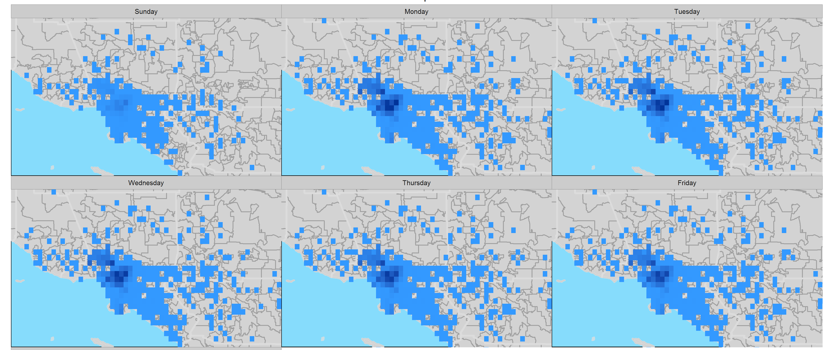
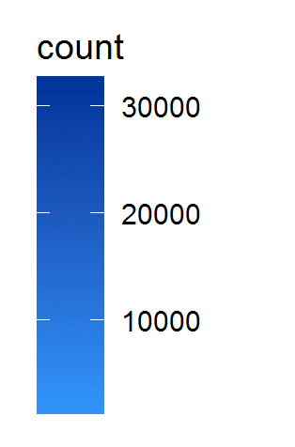
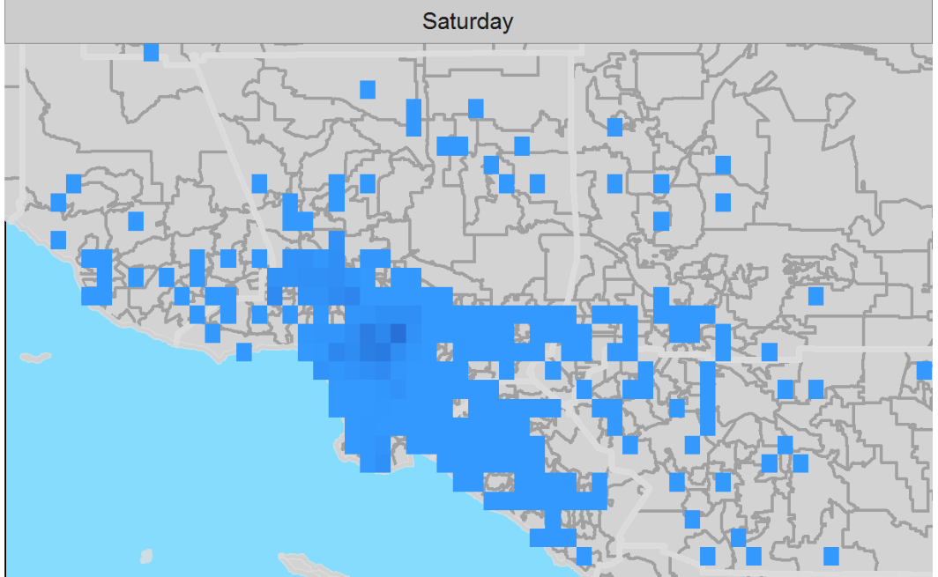
Request Weekly Fluctuation
EXECUTIVE SUMMARY
BACKGROUND
DATA ANALYSIS
DATA VISUALIZATION
CONCLUSIONS
APPENDIX

Slide 22
Why are residents calling?
Request Types and Generated Action Items
Data: Call Center (2011 – 2015)
Service Request (2015 – 2016)
EXECUTIVE SUMMARY
BACKGROUND
DATA ANALYSIS
DATA VISUALIZATION
CONCLUSIONS
APPENDIX

Slide 23
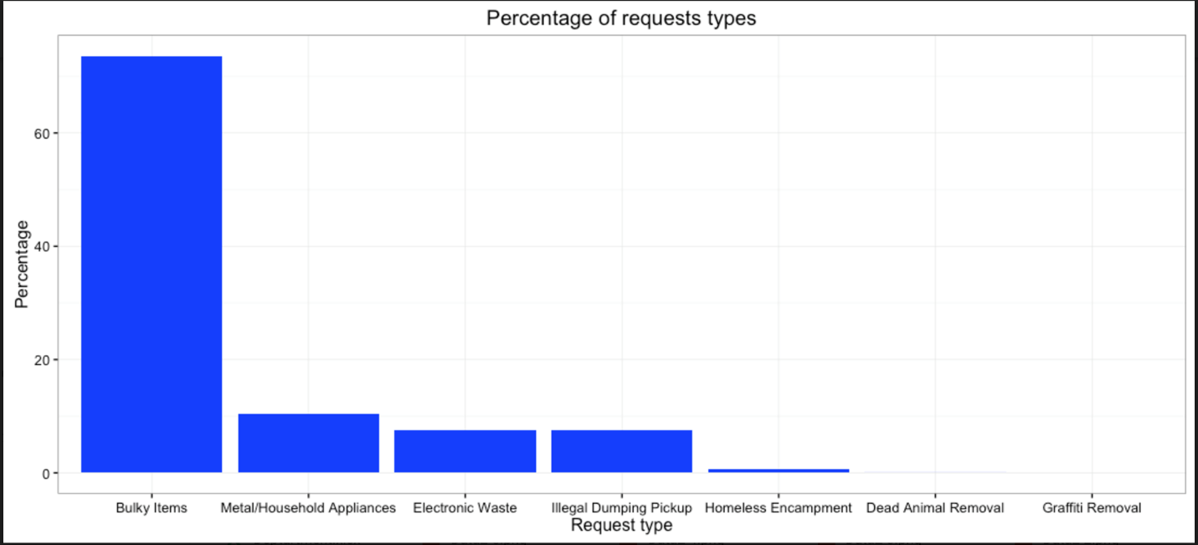
Percentage of Request Types
Service Request (2015 – 2016)
EXECUTIVE SUMMARY
BACKGROUND
DATA ANALYSIS
DATA VISUALIZATION
CONCLUSIONS
APPENDIX

Slide 24
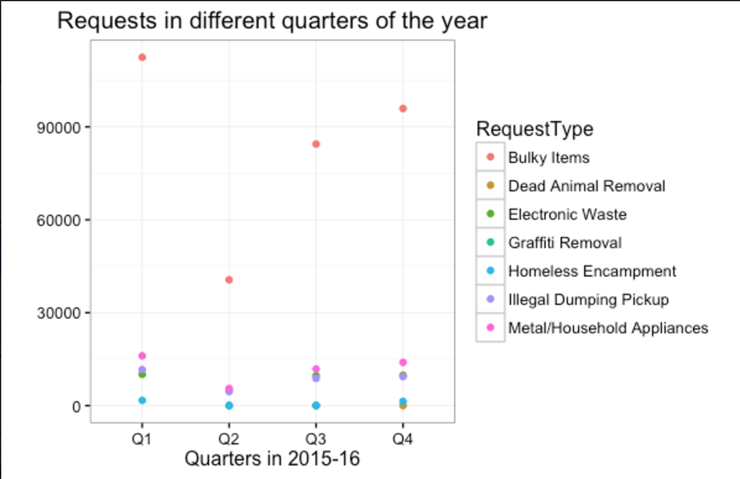
Percentage of Request Types
Graph above uses city’s fiscal calendar
EXECUTIVE SUMMARY
BACKGROUND
DATA ANALYSIS
DATA VISUALIZATION
CONCLUSIONS
APPENDIX

Slide 25
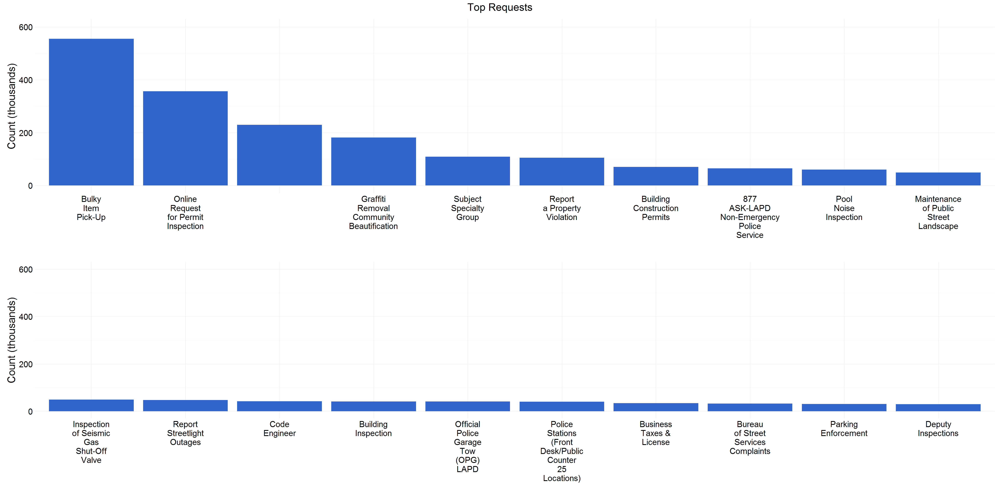
Requests: Top 5
EXECUTIVE SUMMARY
BACKGROUND
DATA ANALYSIS
DATA VISUALIZATION
CONCLUSIONS
APPENDIX

Slide 26
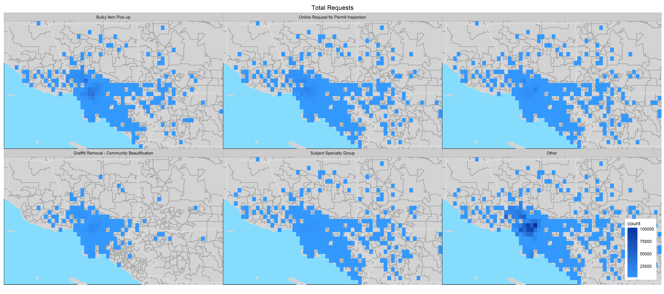
Density of Top Request Types
EXECUTIVE SUMMARY
BACKGROUND
DATA ANALYSIS
DATA VISUALIZATION
CONCLUSIONS
APPENDIX

Slide 27
How are we doing with the request?
Status over 5 years and current record status
Data: Call Center (2011 – 2015)
EXECUTIVE SUMMARY
BACKGROUND
DATA ANALYSIS
DATA VISUALIZATION
CONCLUSIONS
APPENDIX

Slide 28
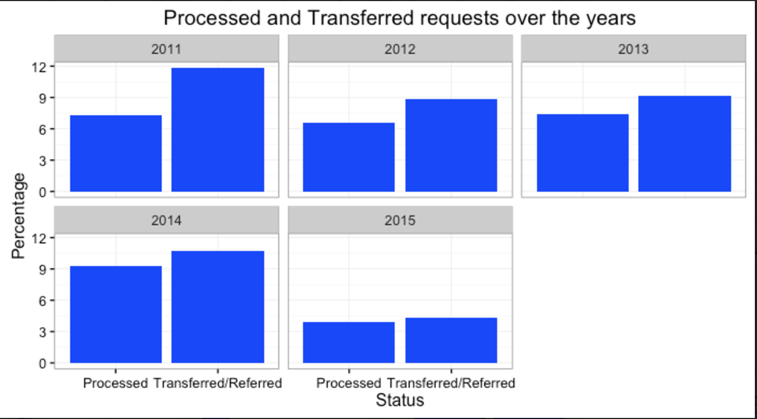
Requests Over 5 Years
EXECUTIVE SUMMARY
BACKGROUND
DATA ANALYSIS
DATA VISUALIZATION
CONCLUSIONS
APPENDIX

Slide 29
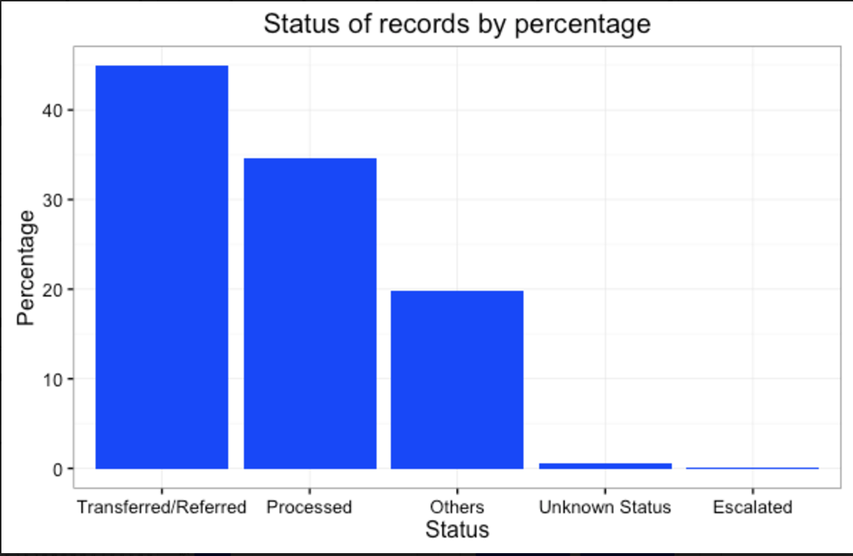
Record Status
EXECUTIVE SUMMARY
BACKGROUND
DATA ANALYSIS
DATA VISUALIZATION
CONCLUSIONS
APPENDIX

Slide 30
Conclusions
Geographic
Calls to the 311 system are concentrated in the DTLA and to a lesser extent the San Fernando Valley and the South Bay in the San Pedro/Long Beach area
Demographics
The majority callers have a yearly income of approximately $40,000 - $70,000, are under the age of 65, and located in areas with a higher rate of renters
Requests
The majority of calls in the system are for transfers or referrals to other city departments, and occur in the beginning of the week starting on Monday and concentrated around 10:00AM and 3:00PM
Platform Utilized
Calling 311 represent about 80% of the requests and the second frequent originates from mobile apps
EXECUTIVE SUMMARY
BACKGROUND
DATA ANALYSIS
DATA VISUALIZATION
CONCLUSIONS
APPENDIX

Slide 31
Recommendations
Improve Existing Data
Create data dictionary repository explaining what the data means and how they are collected
Efficiency Utilize City Resources
Incorporate predictive modeling for 311 system database
Use metrics and analysis to create KPIs to measurably assess efficacy
Proactively concentrate resources on highest demand areas and issues
Streamline Requests
Improve information on self service and web application
Enhance resident education and ease of redirection to appropriate departments to ease burden on 311 call center from transfer calls
EXECUTIVE SUMMARY
BACKGROUND
DATA ANALYSIS
DATA VISUALIZATION
CONCLUSIONS
APPENDIX

Slide 32
Thank You
Questions?
Files and Analysis can be found at: https://github.com/DeepaRamaHegde/LACity311.git
Requires access approval
EXECUTIVE SUMMARY
BACKGROUND
DATA ANALYSIS
DATA VISUALIZATION
CONCLUSIONS
APPENDIX

Slide 33
APPENDICES
EXECUTIVE SUMMARY
BACKGROUND
DATA ANALYSIS
DATA VISUALIZATION
CONCLUSIONS
APPENDIX

Slide 34
Chinatown: 90012
EXECUTIVE SUMMARY
BACKGROUND
DATA ANALYSIS
DATA VISUALIZATION
CONCLUSIONS
APPENDIX

Slide 35
North Hollywood: 91606
EXECUTIVE SUMMARY
BACKGROUND
DATA ANALYSIS
DATA VISUALIZATION
CONCLUSIONS
APPENDIX

Slide 36
Echo Park: 90026
EXECUTIVE SUMMARY
BACKGROUND
DATA ANALYSIS
DATA VISUALIZATION
CONCLUSIONS
APPENDIX

Slide 37
Sawtelle: 90025
EXECUTIVE SUMMARY
BACKGROUND
DATA ANALYSIS
DATA VISUALIZATION
CONCLUSIONS
APPENDIX

Slide 38
Requests
EXECUTIVE SUMMARY
BACKGROUND
DATA ANALYSIS
DATA VISUALIZATION
CONCLUSIONS
APPENDIX

